Slide 1
Modeling ML algorithms for the Walmart Dataset
Ravil Shainidze, Mansurbek Satarov, Nicolas Agreda

Slide 2
What kinds of data
Our dataset includes a mix of categorical and numerical data capturing sales-related information such as
store identifiers, dates, sales figures, holiday indicators,
as well as external factors like
temperature, fuel prices, CPI, and unemployment rates.
These variables provide a comprehensive view of factors that might influence weekly sales at Walmart stores.

Slide 3
Methods for data pre-processing
Data Cleaning
Handling missing data: imputation, deletion of missing values or prediction.
Outlier Detection and Removal: Identify and handle outliers using statistical methods or domain knowledge.
Data deduplication: Identifying and removing duplicate records.
Data transformation
Encoding Categorical Variables: Converting categorical variables into numerical representations suitable for modeling.

Slide 4
Methods for data pre-processing (2)
Feature Engineering
Feature Extraction: Extracting relevant information from raw data, such as extracting date components (year, month, day) from a date column.
Feature Selection: Selecting the most relevant features to improve model performance and reduce overfitting.
Our analyses used these methods for pre-processing.

Slide 5
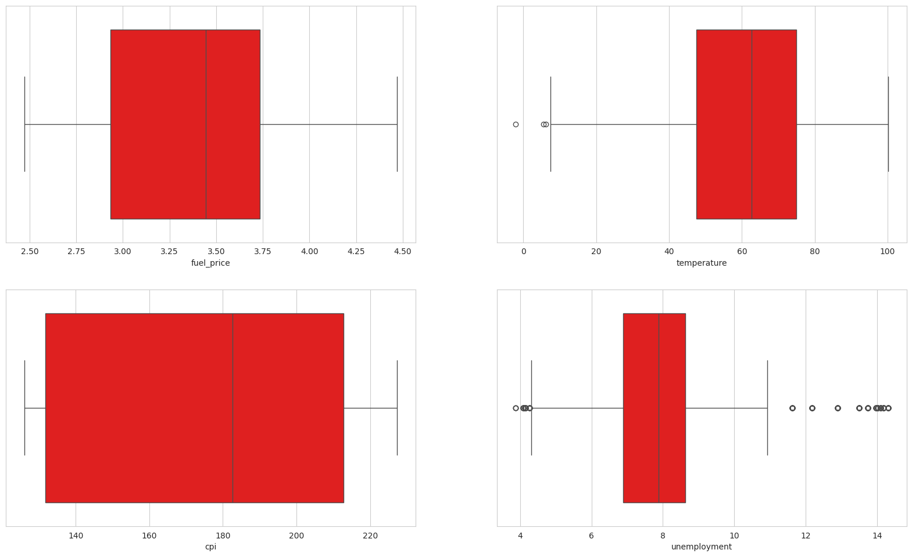
Removed outliers from temperature and unemployment columns.

Slide 6
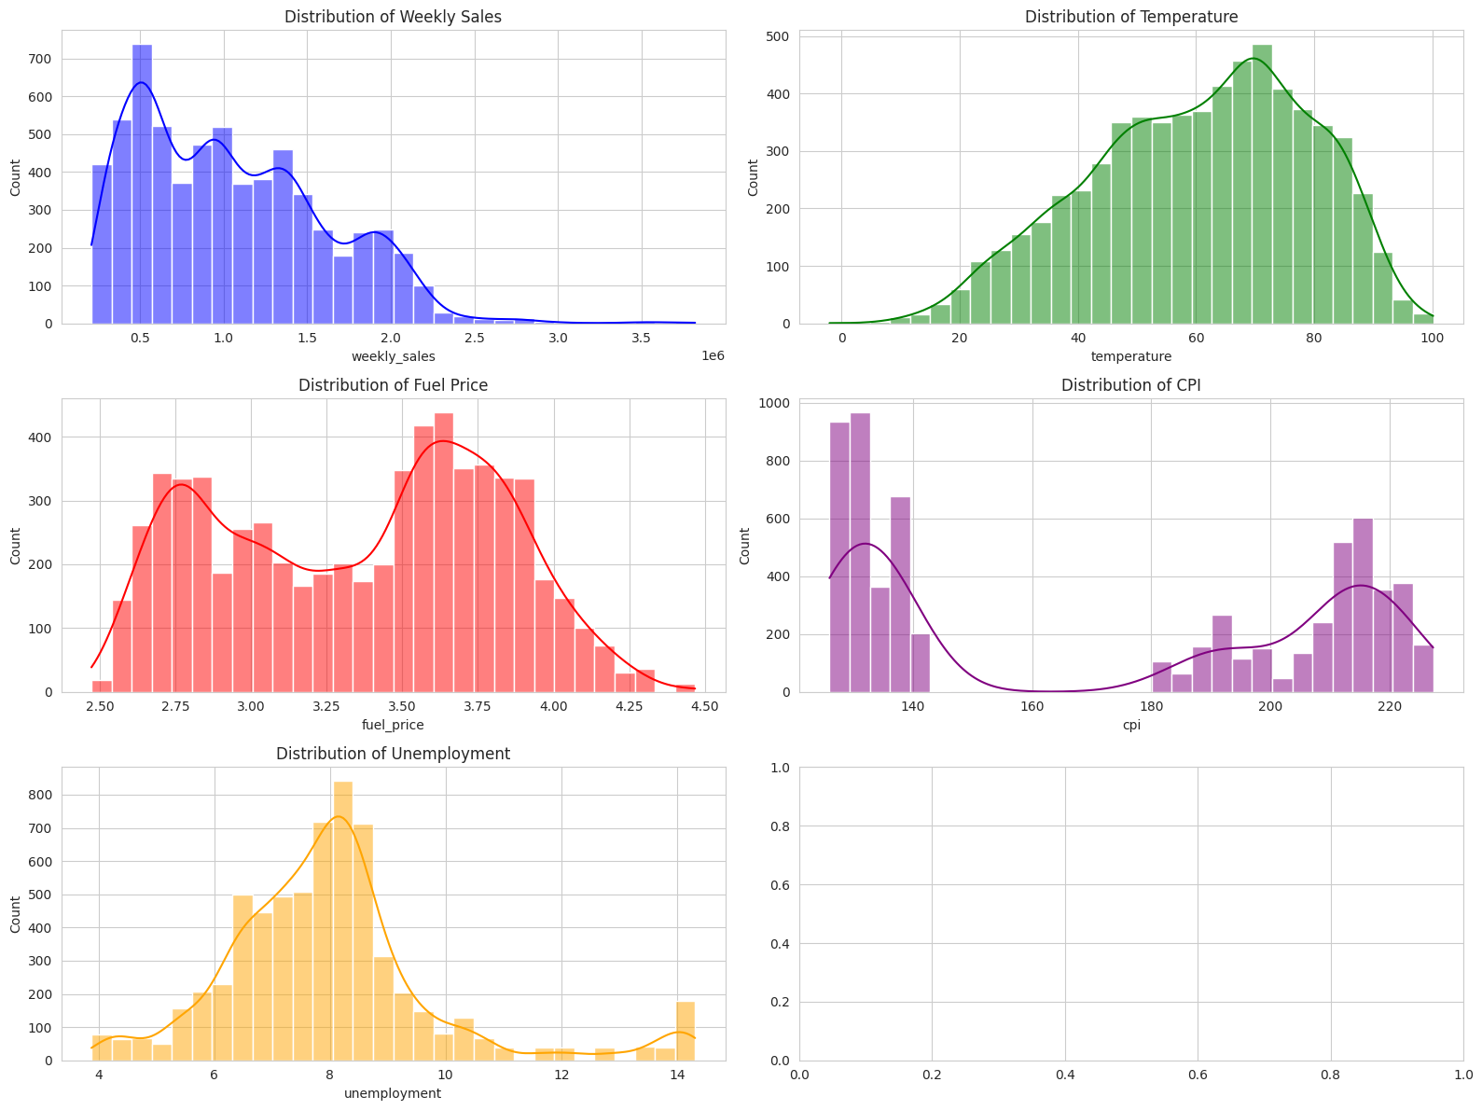
Exploratory Data Analysis
For exploratory data analysis, we used pandas and matplotlib libraries.
To start with, we did distribution analysis on key numerical features.
weekly_sales is right skewed.
Temperature and unemployment follow normal distribution.
CPI and Fuel_Price follow bimodal distribution.

Slide 7
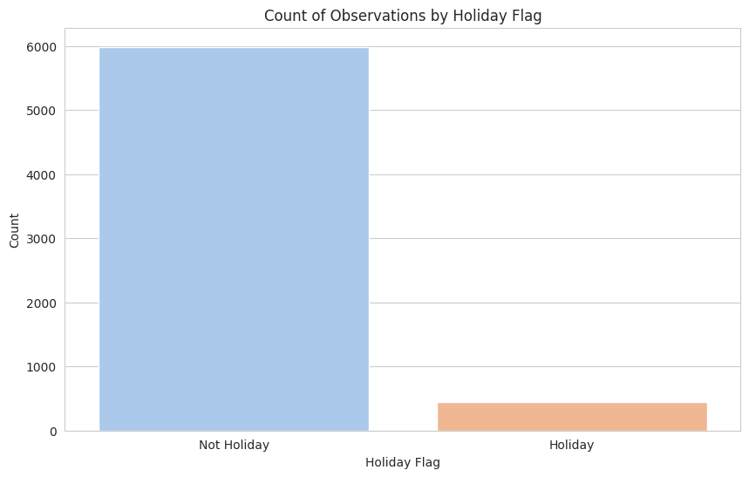
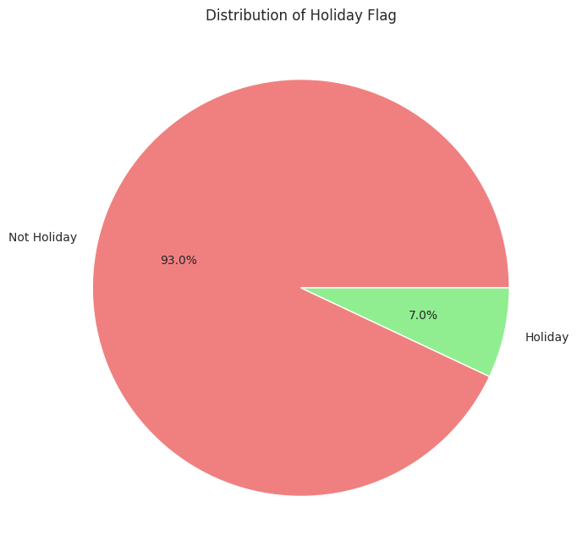
Then we started to analyze the categorical variables.
First, the holiday flag.
We found that the charts follows a typical pattern of holidays and non-holiday days.

Slide 8
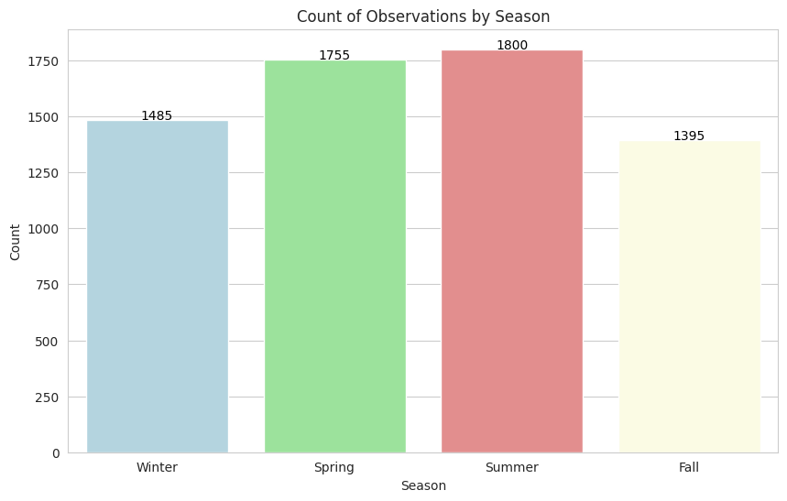
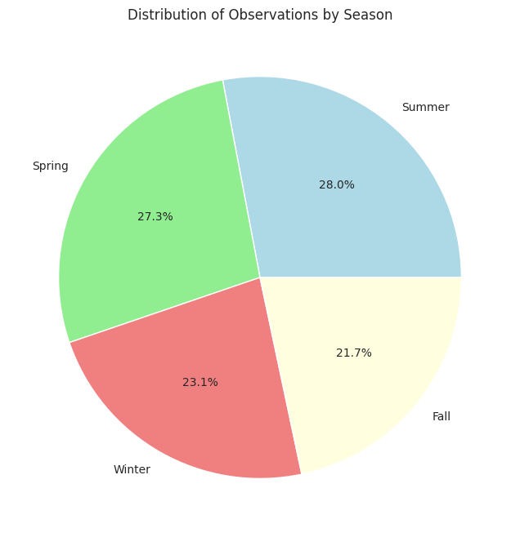
Then, we counted the observations in each season.
Best Performance season is Summer.

Slide 9
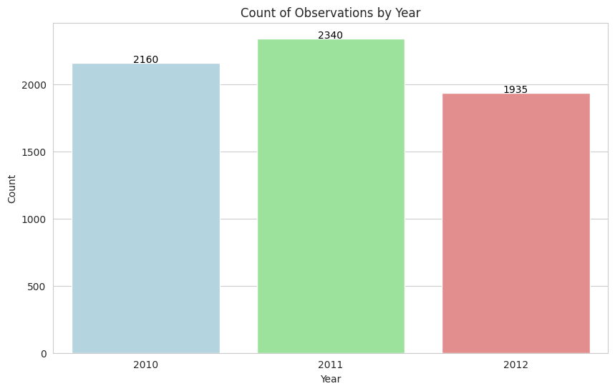
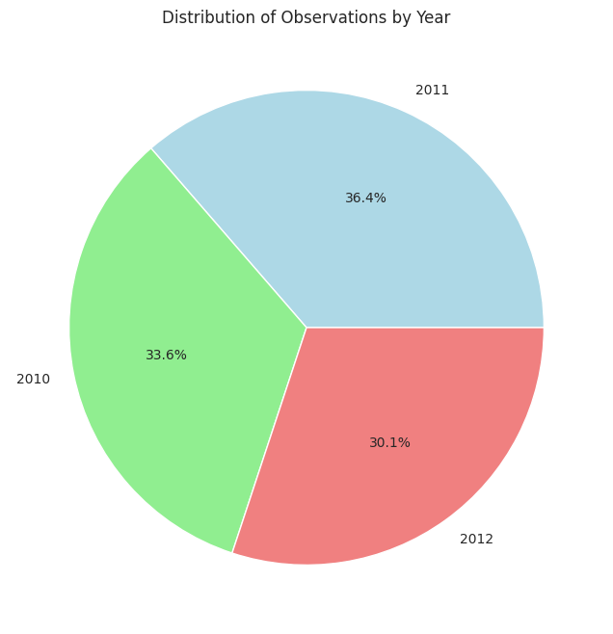
Then, we counted the observations in each year.
2011 seems to be the year with the highest frequency of weekly sales based on this dataset.

Slide 10
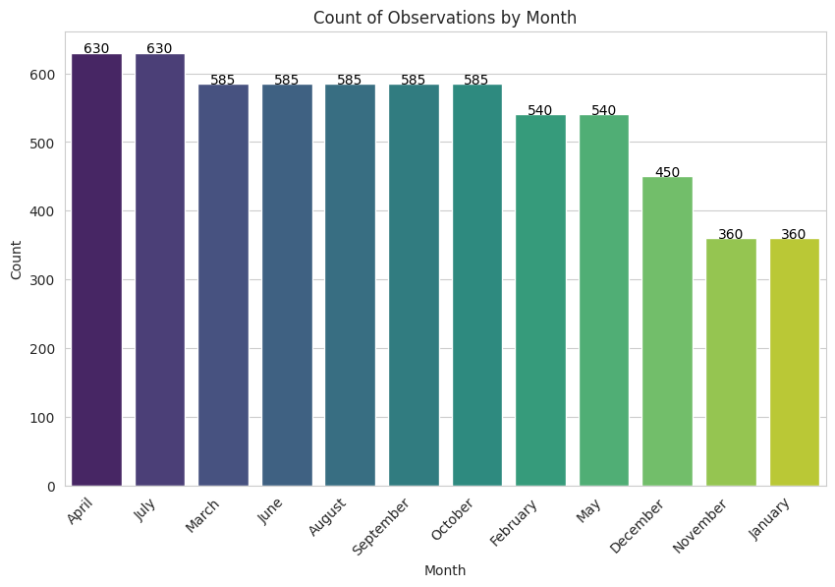
Then, we counted the observations in each month.
April is the most frequent in the dataset because most of the weekly sales were recorded in this month.

Slide 11
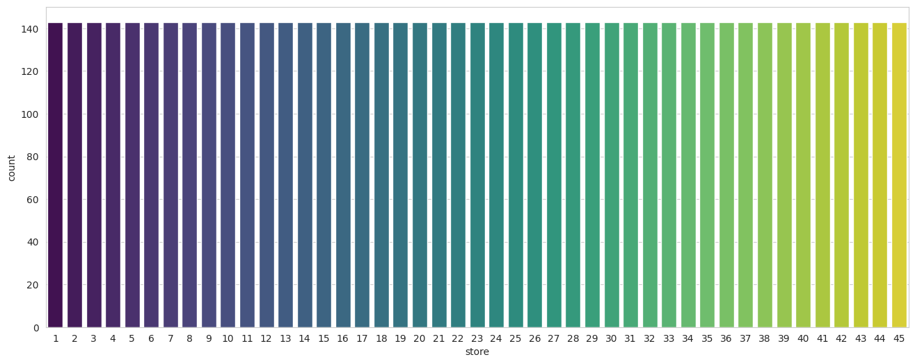
Then, we counted the observations in each store.
All stores are frequent with the same count in the dataset.

Slide 12
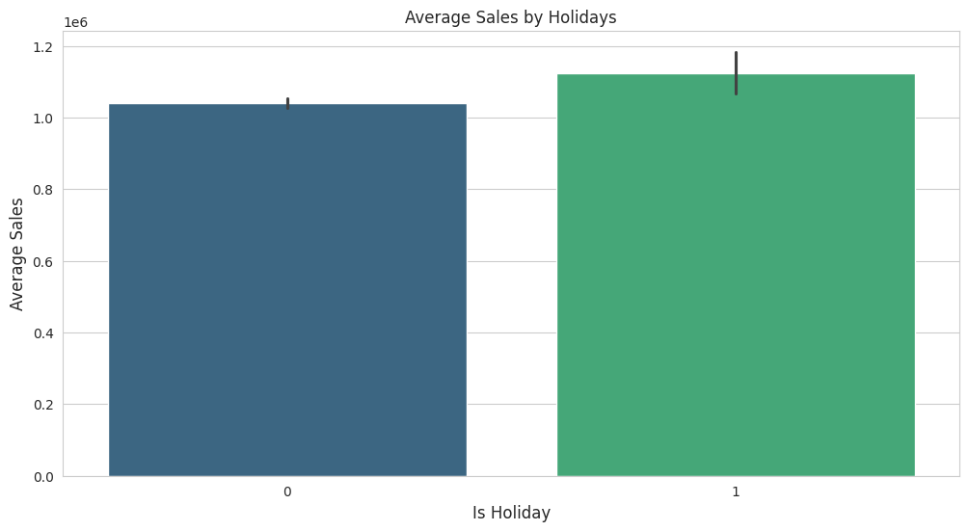
Bi-Variate Analyses
We observed the relationship between average sales and holidays.

Slide 13
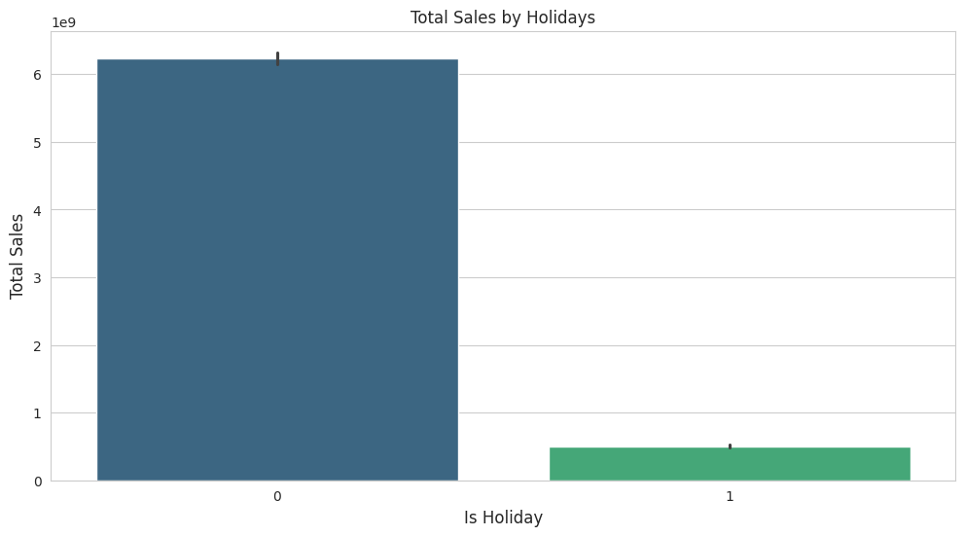
What are the average sales on holidays and regular days?
The rate of sales on holidays is higher than on other days.
Total sales on holidays are lower than on other days, which is normal because the number of holidays is very small compared to the number of other days.

Slide 14
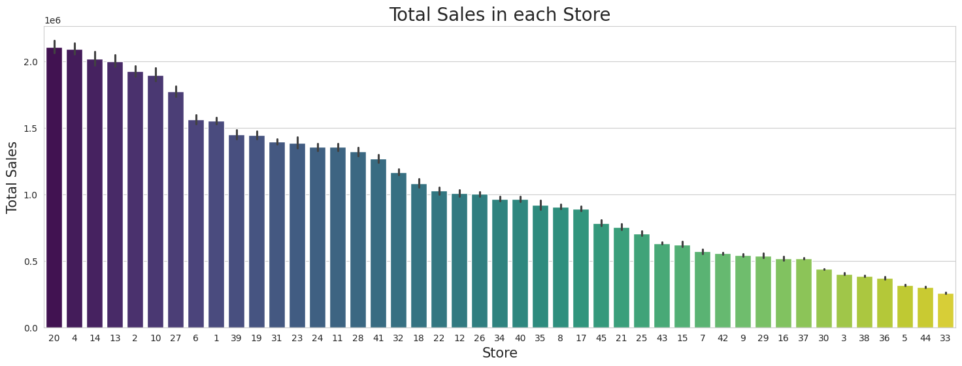
What are the total sales in each store?
There is a high variance in weekly sales from one store to another. Store No. 20 has the highest sales from any store with 301,397,792 followed by Store No. 4 with 299,543,953 and Store No. 33 comes last with 37,160,222$.

Slide 15
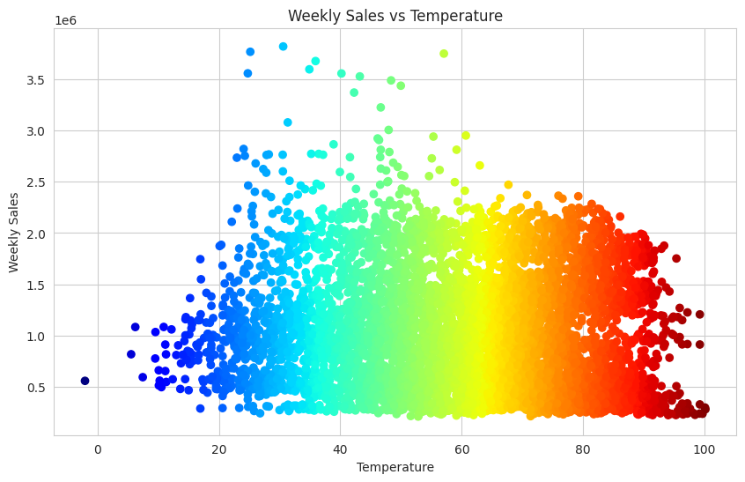
What happens to sales in different temperatures?
Sales are not affected by changes in temperature.

Slide 16
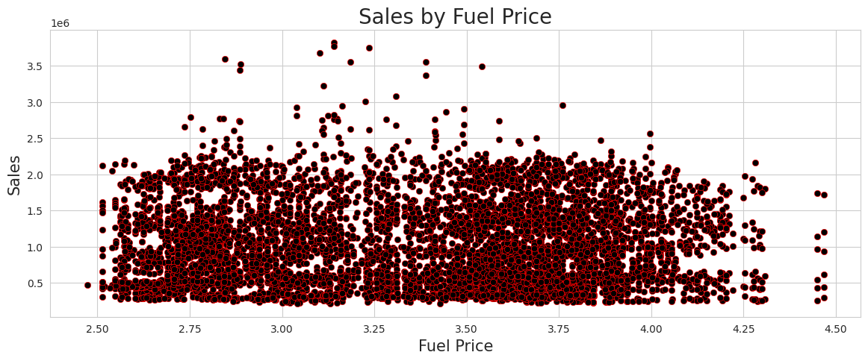
What happens to sales with an increase in fuel price?
Sales are not affected by an increase in fuel price.

Slide 17
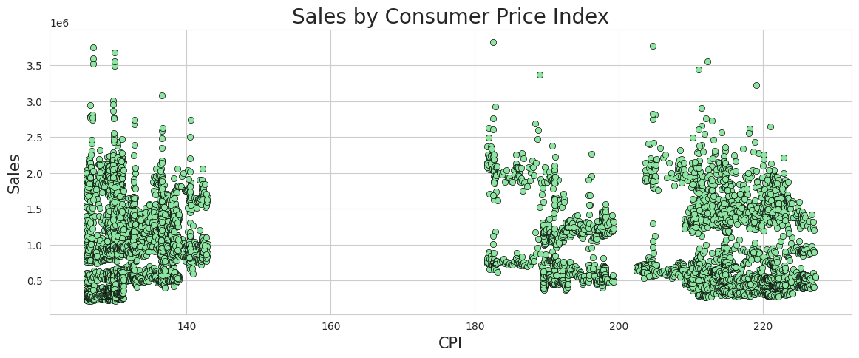
What happens to sales based on Consumer Price Index (CPI) or the consumer's economic condition?
Consumer Price Index (CPI) has little impact on sales. Based on the distribution of typical consumer prices in the figure above, clients can be categorized into two groups: clients that pay from 120 and 150 are considered middle-class clients. consumers who pay between 180 and 230 are considered high-class consumers.

Slide 18
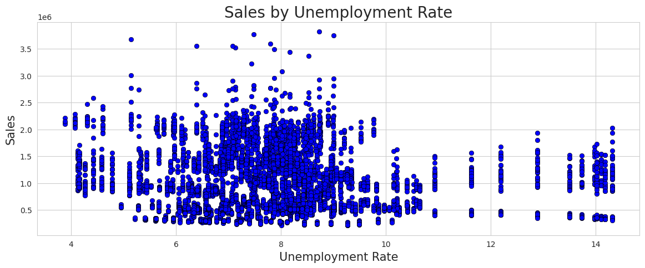
Weekly Sales and Unemployment
Sales are affected by the unemployment rate, so the higher the unemployment rate, the lower the sales.

Slide 19
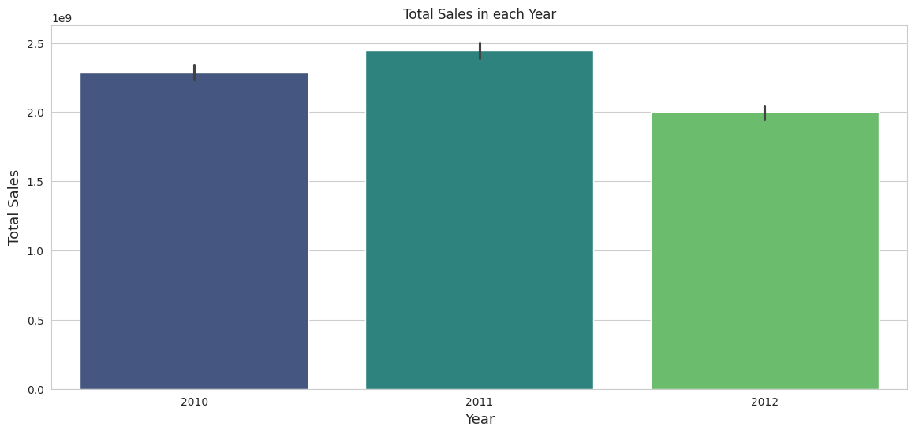
Time Series Analysis
What are the total sales in each year?

Slide 20
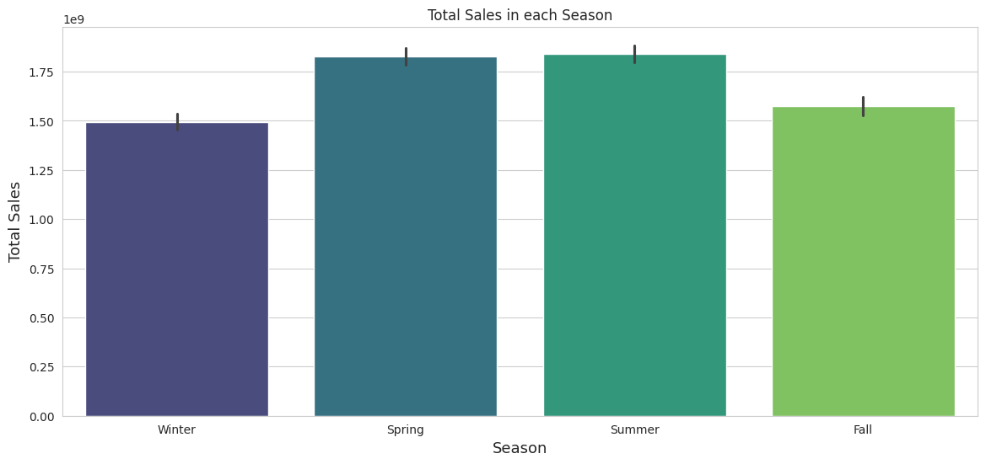
What are the total sales in each season?

Slide 21
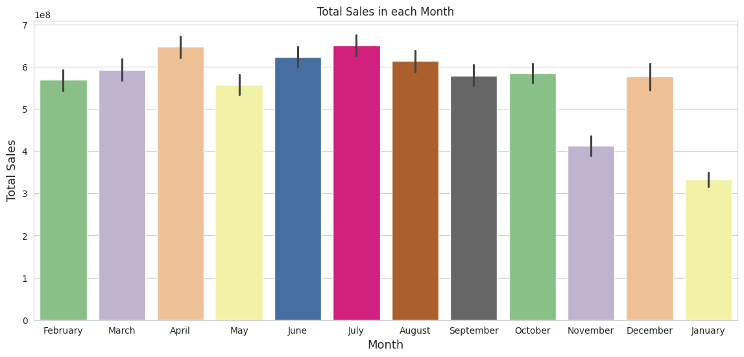
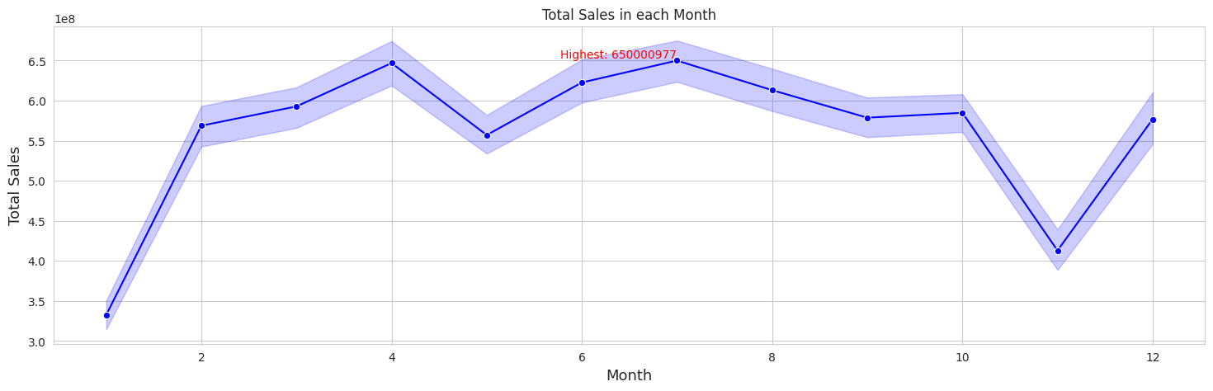
What are the total sales in each month?
Total sales for all years in July are the highest from any month, with 650,000,977$.

Slide 22
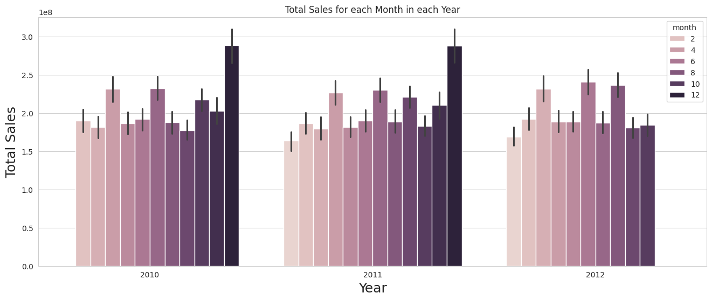
Total sales for each month by all years
Total sales in December 2010, 2011 are the highest in the three years, where:
In 2010, total sales in December were the highest with 288,760,533.
In 2011, total sales in December were the highest with 288,760,533.
In 2012, total sales in June were the highest with 240,610,329$.

Slide 23
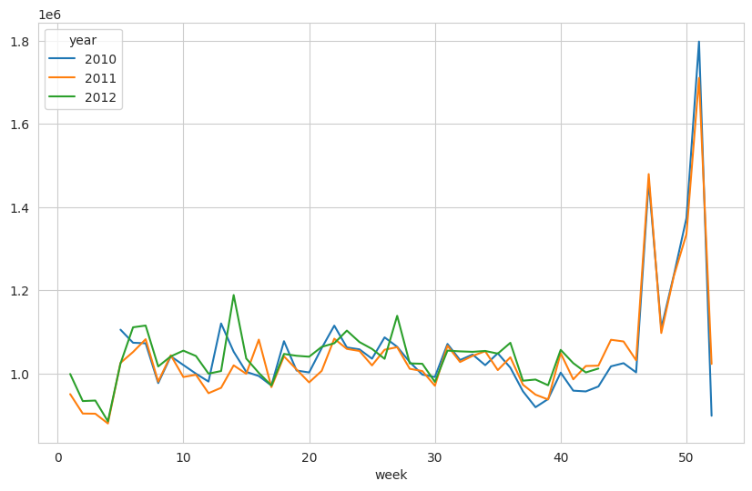
Total sales in each week by all years
Total sales for all years in week 51 are the highest from any week, with 157,929,657$

Slide 24
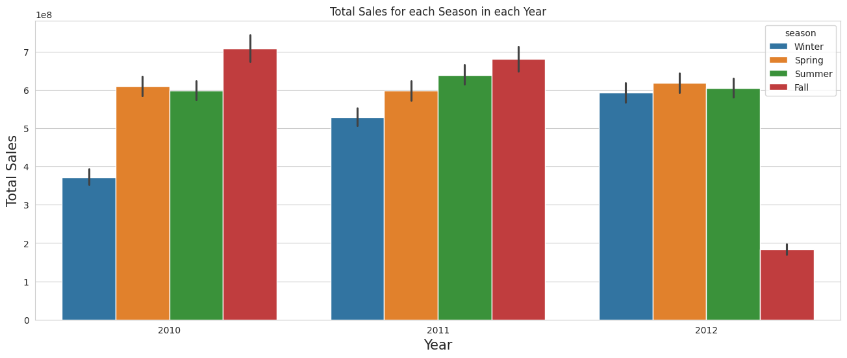
What are the total sales in each year regarding the season?

Slide 25
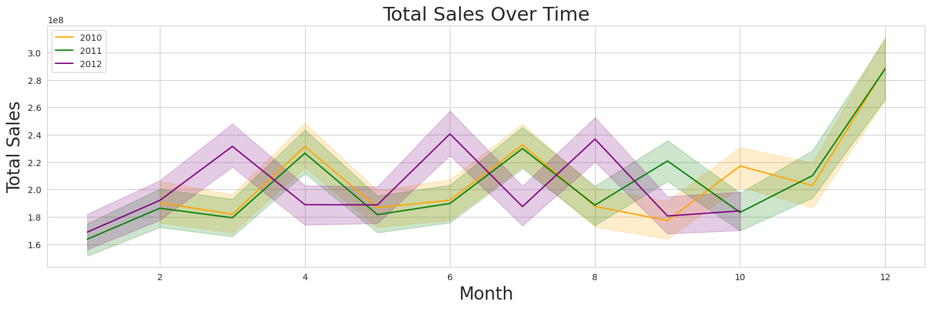
What happened to the total sales over time?
Sales are similar in most months, but they increased at the end of 2010 and 2011 and decreased at the end of 2012.

Slide 26
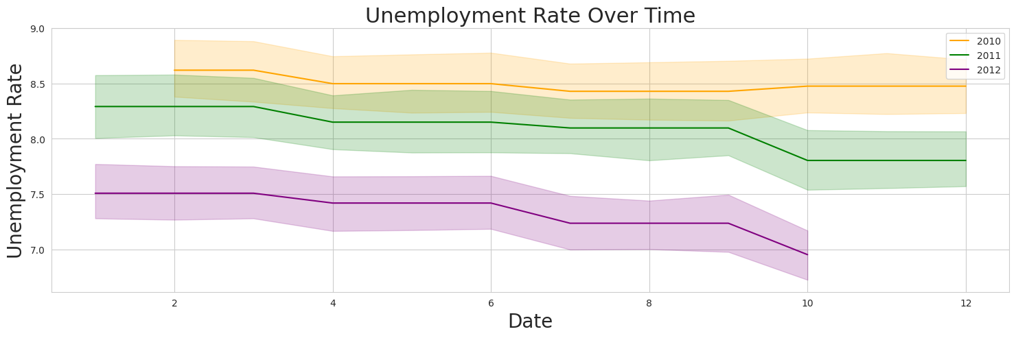
What happens to the unemployment rate over time?
The unemployment rate decreases over time.

Slide 27
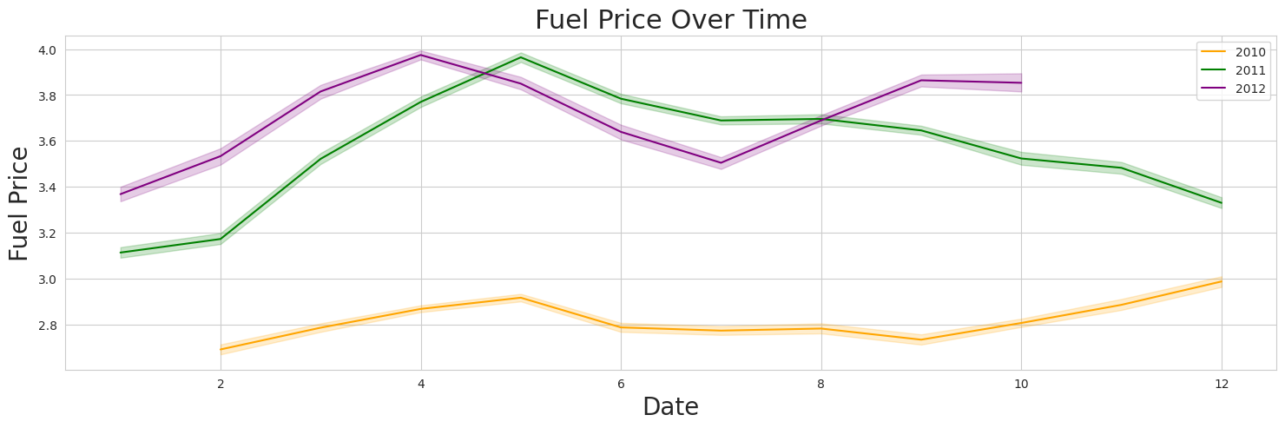
What happens to the fuel price rate over time?
The fuel price increases over time.

Slide 28
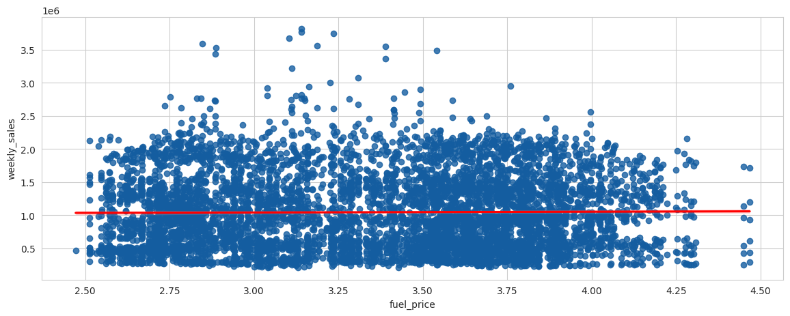
Data Correlation
Fuel Price vs. Weekly Sales
Since the p-value is > 0.1, the correlation between fuel price and weekly sales is not statistically significant.
Fuel price does not seem like a good predictor of the weekly sales at all since the regression line is close to horizontal. Therefore, it's not a reliable variable.

Slide 29
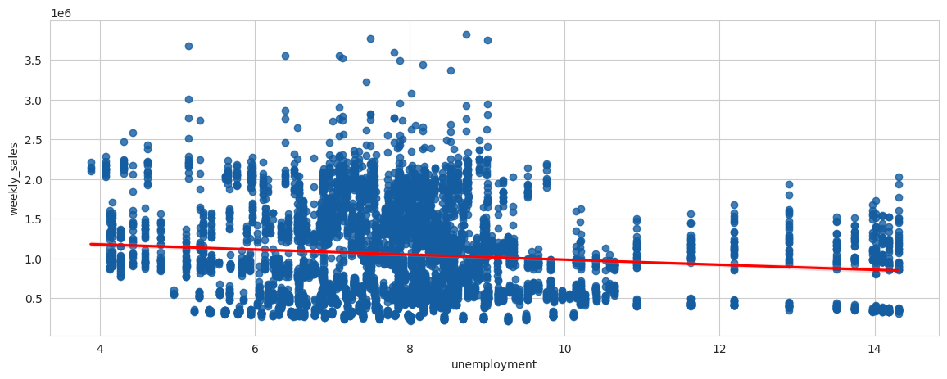
Unemployment vs. Weekly Sales
Since the p-value is < 0.001, the correlation between unemployment and weekly sales is strong evidence that the correlation is significant.
Unemployment seems like a good predictor of the weekly sales, The higher the unemployment rate, the lower the weekly sales.

Slide 30
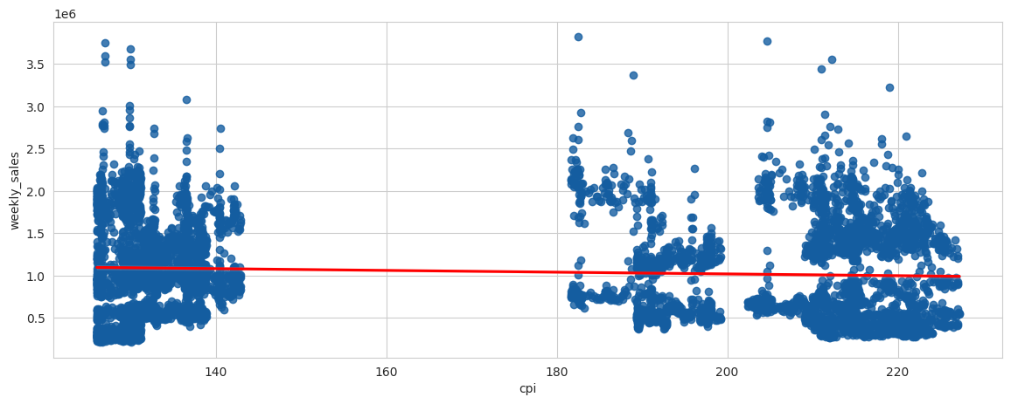
CPI vs. Weekly Sales
Since the p-value is < 0.001, the correlation between CPI and weekly sales is strong evidence that the correlation is significant.

Slide 31
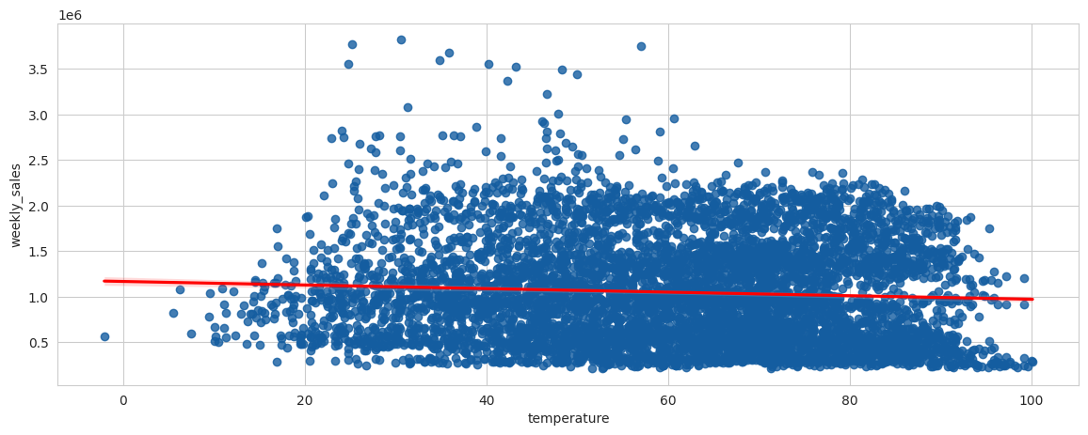
Temperature vs. Weekly Sales
Since the p-value is < 0.05, the correlation between temperature and weekly sales is moderate evidence that the correlation is significant.
Temperature seems like a good predictor of the weekly sales, The higher the Temperature rate, the lower the weekly sales.

Slide 32
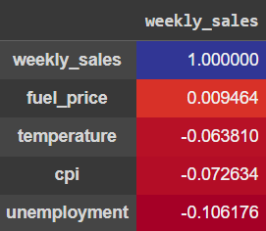
Data Correlation Analysis
To summarize, the evidence indicates that lower temperatures, a higher Consumer Price Index, and increasing unemployment have a negative influence on weekly sales. Meanwhile, there is a slight positive association between fuel prices and sales. These observations can be beneficial for comprehending and forecasting the aspects that impact sales performance.

Slide 33
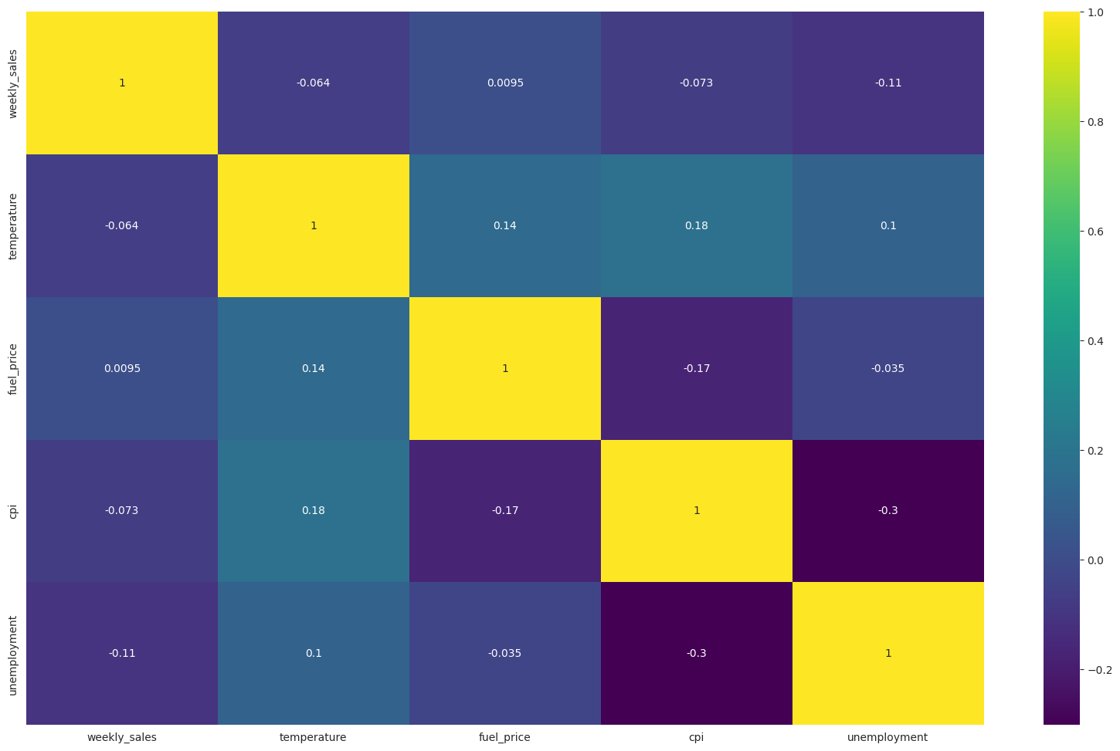

Slide 34
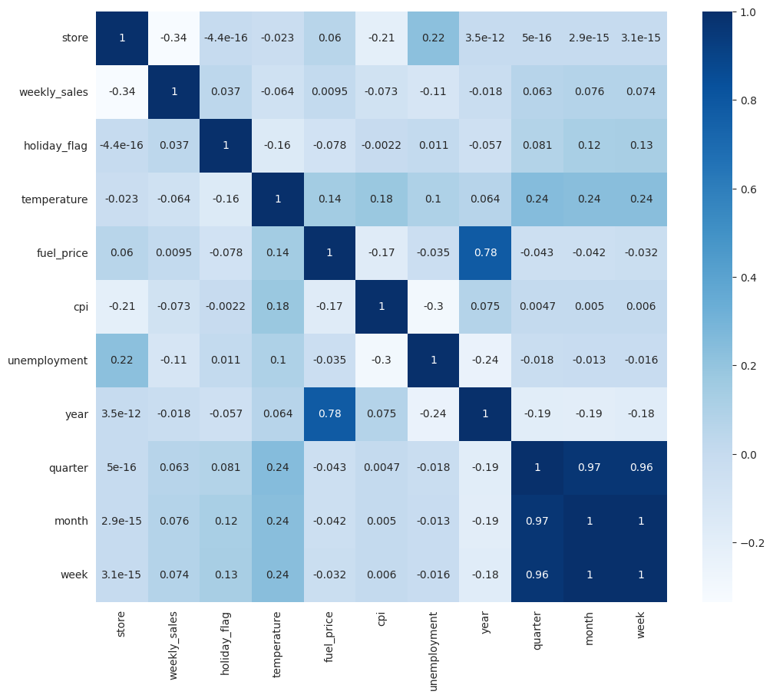
Correlation matrix

Slide 35
Testing and Training
To test and train the data, we decided to split it into two parts with the ratio of 80/20.
Then we used data transformation algorithms to split the data into categorical and numerical features.
We used sklearn library for data transformation pipeline and modeling.

Slide 36
Model performance evaluation
We tried Linear Regression and K-Nearest Neighbors (KNN) Models for our dataset.
There are multiple techniques for evaluating the performance of regression models, such as cross-validation, R2 – R-Squared and MSE – Mean Squared Error.
MSE represents the residual error which is nothing but sum of squared difference between actual values and the predicted / estimated values divided by total number of records.
R-Squared represents the fraction of variance captured by the regression model.
The disadvantage of using MSE is that the value of MSE varies based on whether the values of response variable is scaled or not. If scaled, MSE will be lower than the unscaled values.

Slide 37
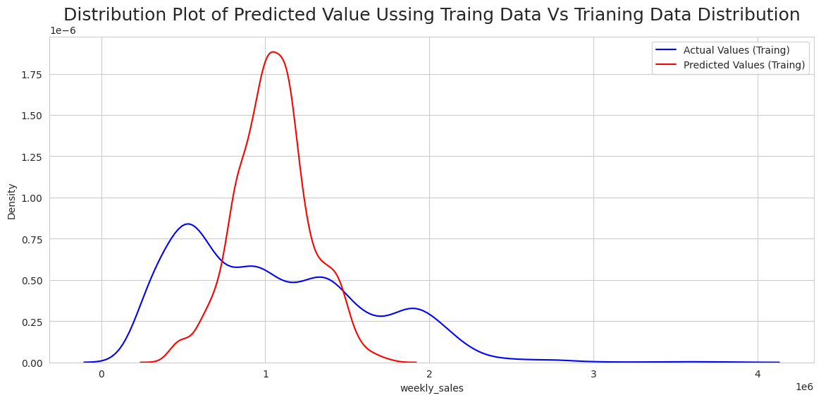
Regression model
Evaluation of the LinearRegression Model:
Root Mean Squared Error: 522051.03
R-Square score Training: 16.11 %
There are no linear correlations Between variable and target, The model seems to be not doing well learning from the training dataset, so we need to increase the complexity of this model. Let’s use Polynomial Features for the data.

Slide 38
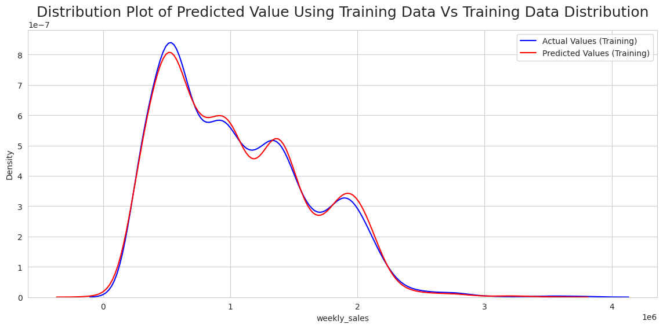
Tuning The Model with Polynomial Regression Model
Cross Validation Scores:
0.960, 0.962, 0.959, 0.967, 0.958
Mean of Scores: 96.16 % Standard Deviation of Scores: 0.00327
Testing Accuracy:
Root Mean Squared Error: 67122.63
R-Square score Training: 98.61 %
After we realized that the R-Squared score was very low, we decided to tune the model for better accuracy using the Polynomial Regression.
After applying Polynomial Features to the training data, The model seems to have improved more in learning from the training dataset.

Slide 39
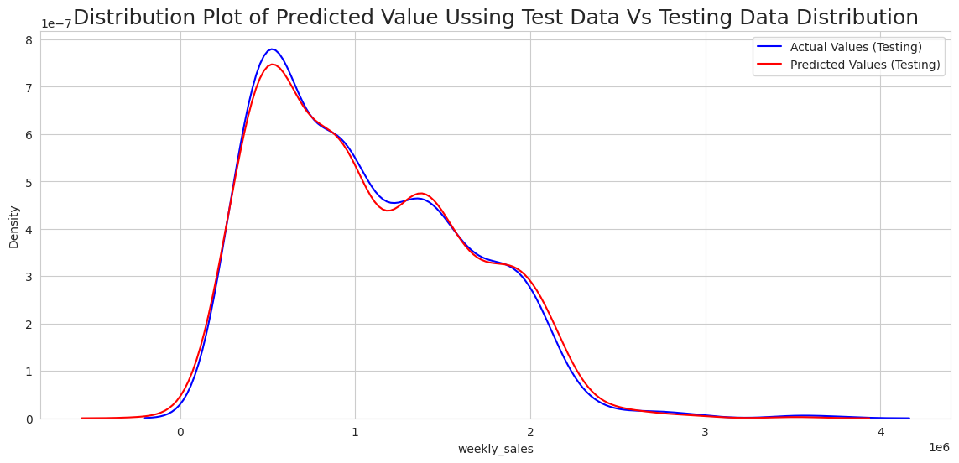
After testing the polynomial regression model, it became clear that the model had learned sufficiently, as its accuracy was 96.84 %.

Slide 40
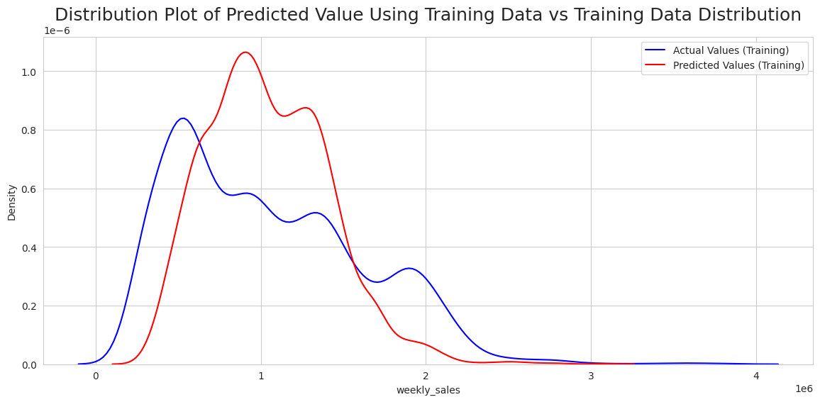
KNN Modeling
Training Accuracy:
Root Mean Squared Error: 358918.31
R-Square score Training: 60.35 %
The model seems to be doing not bad in learning from the training dataset.

Slide 41
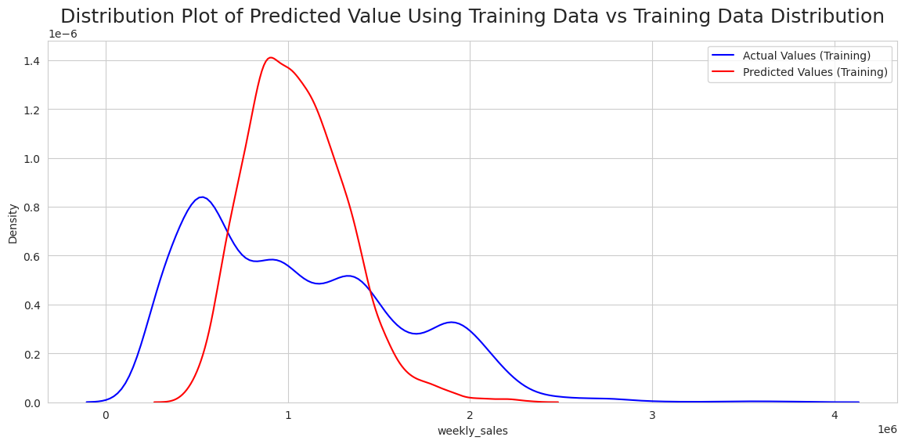
Tuning the KNN Model with hyperparameter tuning
Training Accuracy: Root Mean Squared Error: 395434.36
R-Squere score Training: 51.87 %
Based on the accuracy, we did not find the KNN model to be useful.

Slide 42
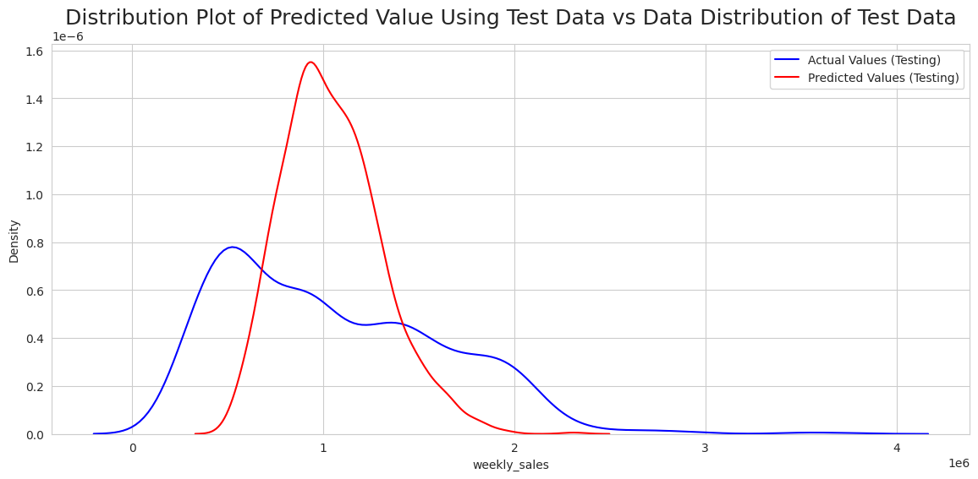
Testing
Testing Accuracy:
Root Mean Squared Error: 422689.74
R-Square score: 45.37 %
Cross Validation Scores:
0.422, 0.381, 0.401, 0.459, 0.425, 0.414, 0.411, 0.433, 0.430, 0.464.
Mean of Scores: 42.45 %
Standard Deviation of Scores: 0.02358

